Slide 1


FOREIGN DIRECT INVESTMENT ANALYTICS
Presented By : Tanaya Harley

Slide 2



INTRODUCTION
FOREIGN DIRECT INVESTMENT (FDI)
Any investment from an individual or firm that is located in a foreign country into a country is Foreign Direct Investment (FDI), whereby the foreign entity equires ownership or controlling stake in the shares of a company.

Slide 3

PROBLEM STATEMENT
Have to conduct a detailed year-wise (from 2000-2017) analysis of the FDI landscape in India to uncover sector-wise trends, peaks and troughs by identifying key metrics and factors and show meaningful relationships between various attributes to mitigate risk and find equilibrium investment

Slide 4
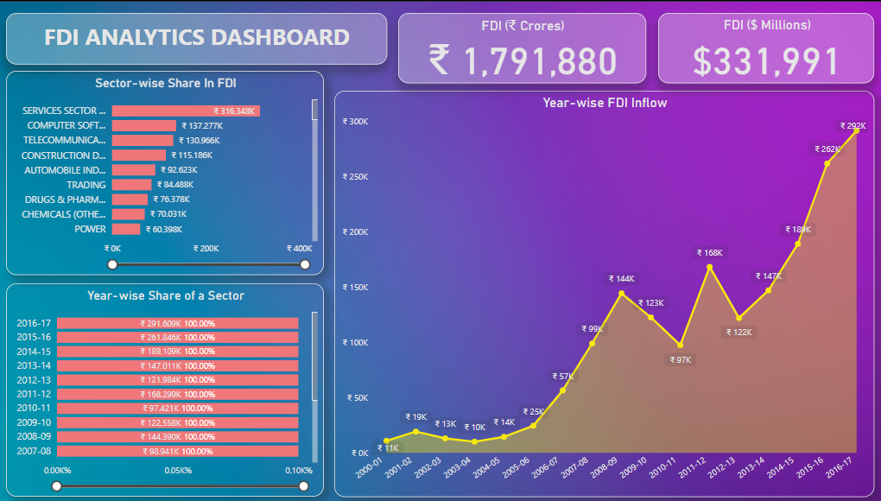
MY DASHBOARD

Slide 5
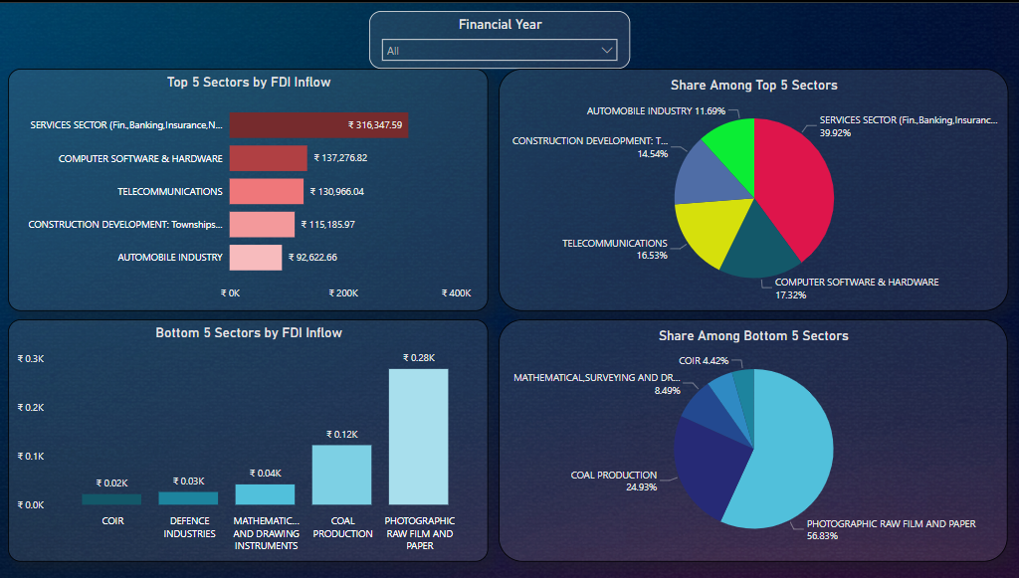
MY DASHBOARD

Slide 6
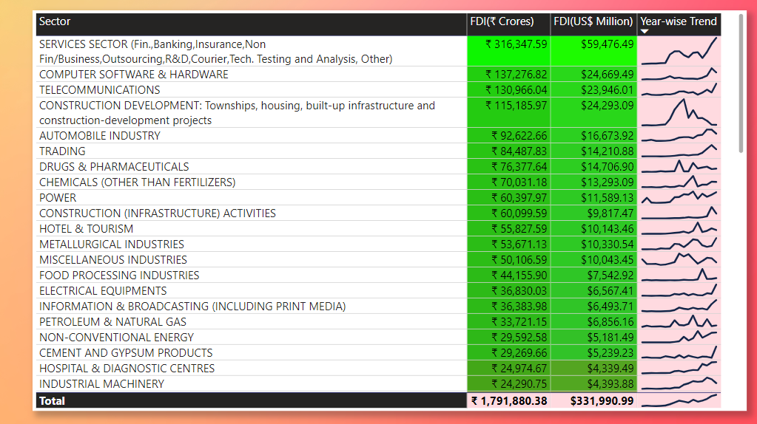
MY DASHBOARD

Slide 7

INSIGHTS GENERATED
The Sectoral composition of FDI over the period of April 2000 to June 2017, we can find that the largest recipient of such investment is service sector (Financial and non-financial services). The share of this sector in FDI flows is 17 % of the inflow total foreign direct investment.
The foreign investors are interested in mainly financial services due its profit generating advantage. This sector gives scope for the foreign investor to takes back the profits to the home country. As service sector the services are consumed in the host country and there by generating outflow of funds from the host country.

Slide 8
INSIGHTS GENERATED
The second recipient is Computer software and hardware which shares 7% of total FDI. Telecommunication,, Construction Development , Automobile industry, Trade, Drugs and pharmaceuticals, Chemical ( Other than Fertilizers),Power, Construction, Hotel and tourism contribute around 7%,6%, 5%, 4.7%, 4%, 4%, 3%, 3%.
There is very low interest towards sectors like Coir, Defence Industries, Mathematical, surveying and drawing Instruments, Coal Production and there are around 28 to 30 sectors where share is less than or equal to 1%.

Slide 9




Thank you !

